Slide 1
Designing and Scoping a Data Science Project
Data Science for Beginners, Session 1
Notes:
Welcome to class. There are no prerequisites for these sessions, except a curiosity to learn about data science and willingness to play with data.

Slide 2
About these Sessions
Notes:
Just a little about what to expect in these sessions.

Slide 3
Session Format
Before each session:
Install required tools (see the ‘tool install instructions’ page)
Do background reading (see the ‘course reading list’ page)
During each session:
One topic
Learn 5-7 concepts related to that topic
Try apps or code related to that topic
After each session:
Try the code in that session’s notebooks
Notes:
This is what we’ll do each week. There’s also a recommended reading list, and lab notes for each class, if you really get into one of the topics.
Having fun is optional, but much recommended.

Slide 4
Session Topics
People
Designing a data science project
Communicating results
Tools
Python basics
Getting Data
Acquiring data
Cleaning and exploring data
Special data types
Handling text data
Handling geospatial data
Handling big data
Learning from data
Machine learning
Learning relationships from data
Notes:
The labs are designed to cover most of what you need to talk to data scientists, to specify your project, and to start exploring data science on your own. They’re specifically aimed at the types of issues that you’ll see in the messy strange world of development, humanitarian and social data.
Here are the sessions, grouped by theme.

Slide 5
Sessions Timeline
Scoping a data science project
Python basics
Acquiring data
Communicating results
Cleaning and exploring data
Machine learning
Handling text data
Handling geospatial data
Learning relationships from data
Handling big data
Notes:
Here are the sessions in chronological order. Why don’t we do sessions in the theme order? Because we want you to have some breathing space between the more difficult topics, and we want you to be able to do useful things as early as possible.

Slide 6
Session 1: your 5-7 things
What is data science?
Data science is a process
What’s a data scientist?
Data science competitions
Writing a problem statement
Data science ethics
Notes:
So let’s begin. Here are the 6 things we’ll talk about today.

Slide 7
What is Data Science?
Notes:
Before we talk about doing data science, it helps to define it a bit.

Slide 8
Defining Data Science
“A data scientist… excels at analyzing data, particularly large amounts of data, to help a business gain a competitive edge.”
“The analysis of data using the scientific method”
“A data scientist is an individual, organization or application that performs statistical analysis, data mining and retrieval processes on a large amount of data to identify trends, figures and other relevant information.”
Notes:
Data science is a process. It’s based on science, which is all about finding patterns that fit our knowledge of the world. In many ways, the “science” in data science follows the scientific method.
The scientific method, mentioned here, is to:
Ask a question
Do background research
Construct a hypothesis
Test your hypothesis by doing an experiment
Analyse your data and draw a conclusion
Communicate your results
[O’Neill & Schutt, “Doing data science”]. Most of science works like this.

Slide 9
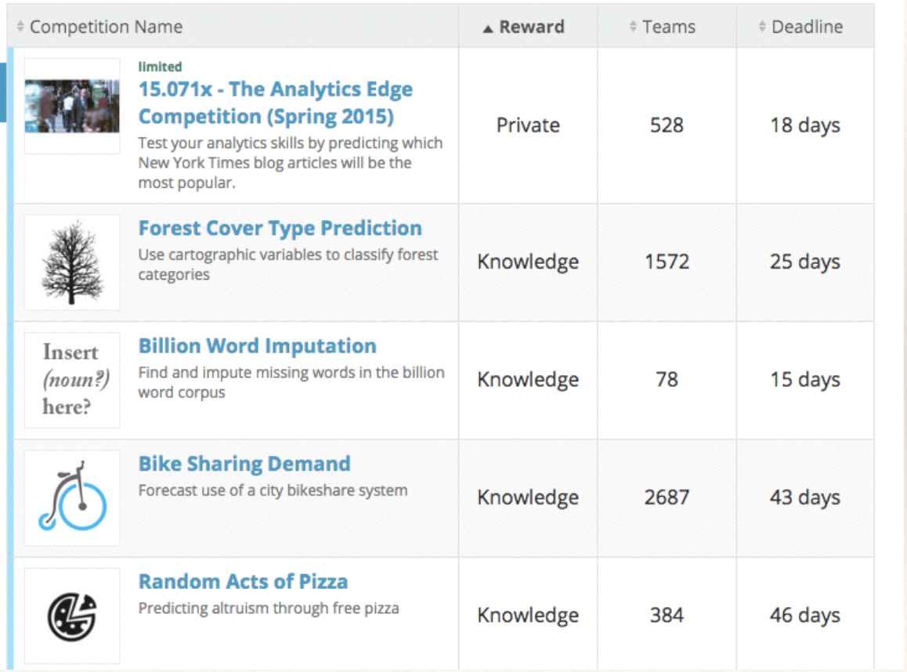
Understanding through Data
Notes:
Sometimes the best way to understand data scientists is to go look at what they do. This is the Kaggle competition list last year (Kaggle is one of the largest data science competition sites). Kaggle isn’t *all* that data scientists do - it focusses on the analysis and machine learning part of the process.

Slide 10
Data Science is a Process
Ask an interesting question
Get the data
Explore the data
Model the data
Communicate and visualize your results
Notes:
We’ll use this process as the backbone of what we do on a data science project. You also, as part of this process, need to sanity-check the results, in the context they’re relevant to. This is especially important in a development data context, where data is hard to come by and may be erroneous, miss areas or demographics and potentially be older than it looks.
You might also hear data scientists mention the OSEMN process (Obtain-Scrub-Explore-Model-Interpret):
Obtain datasets
Clean, combine, transform data
Explore the data
Try models (classification, machine learning etc)
Interpret and communicate your results

Slide 11
Ask an interesting question
Write hypotheses that can be explored
Do people have more phones than toilets?
How is Ebola spreading?
Is using wood fires sustainable in rural Tanzania?
Can we feed 9 billion people?
Make them simple, actionable, incremental
Notes:
Sarah Cohen (NYT) wrote that “Every good story starts with an idea, a question or an observation”.

Slide 12
Get the data
Data files (CSV, Excel, Json, Xml...)
Databases (sqlite, mysql, oracle, postgresql...)
APIs
Report tables (tables on websites, in pdf reports...)
Text (reports and other documents…)
Maps and GIS data (openstreetmap, shapefiles, NASA earth images...)
Images (satellite images, drone footage, pictures, videos…)
Social media (twitter, facebook, instagram, youtube...)
People (formal surveys, phone surveys, asking questions)
...
Notes:
These are all data sources. Some of them are harder to get information out of than others, but they all contain data.

Slide 13
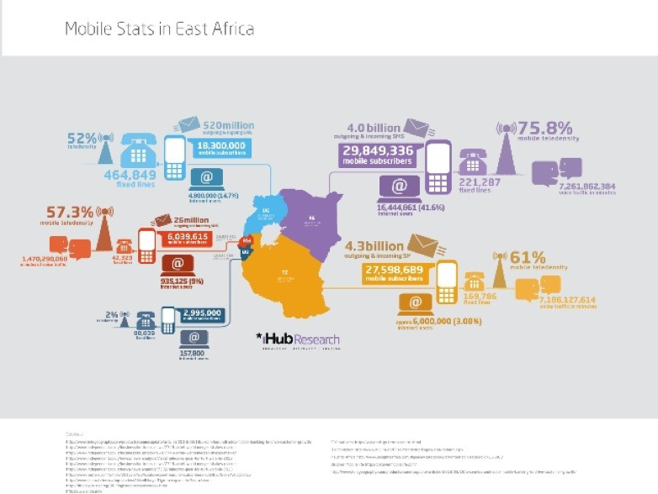
Most data is small, but…
Notes:
Big data has high volume, velocity, variety and veracity. We’ll talk about that later, but most of the data we’re looking at will fit easily on a PC.

Slide 14
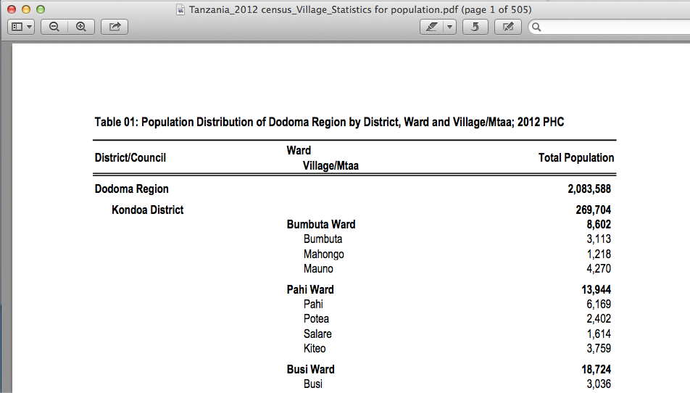
Reformat the data
Notes:
Data is always dirty, and usually needs cleaning. Issues include file formats (pdfs!), badly-specified locations, human errors and differences between standards (e.g. “Tanzania” vs “Republic of Tanzania”).
Almost always, you end up formatting input data so it can be read into algorithms. This is the start of a dataset that I received as an 80-page pdf.

Slide 15
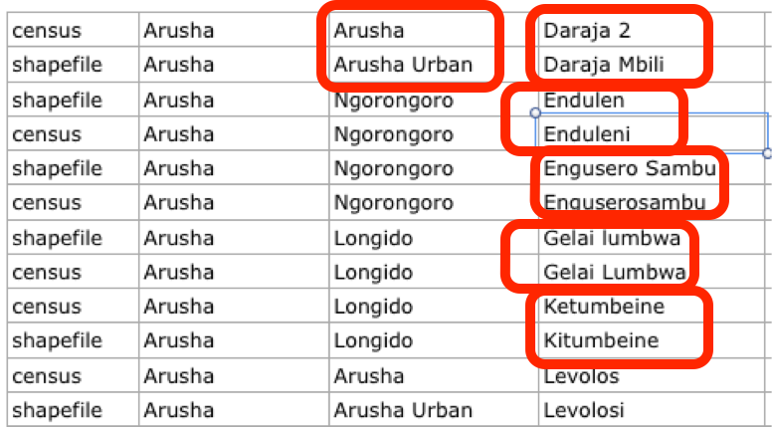
Explore the data
Notes:
Once you’ve got the dataset in machine-readable form, you can start looking for more issues to deal with (e.g. these issues with different placename standards in Tanzania) and, eventually, for potentially interesting patterns.
Eyeballing (looking at) your data is usually a good place to start; often you have to take a subset of the whole dataset to do this, but it’s usually worth it to get a better feel for what’s contained in each dataset. Doing quick but ugly visualisations of your data is also a good thing to do.

Slide 16
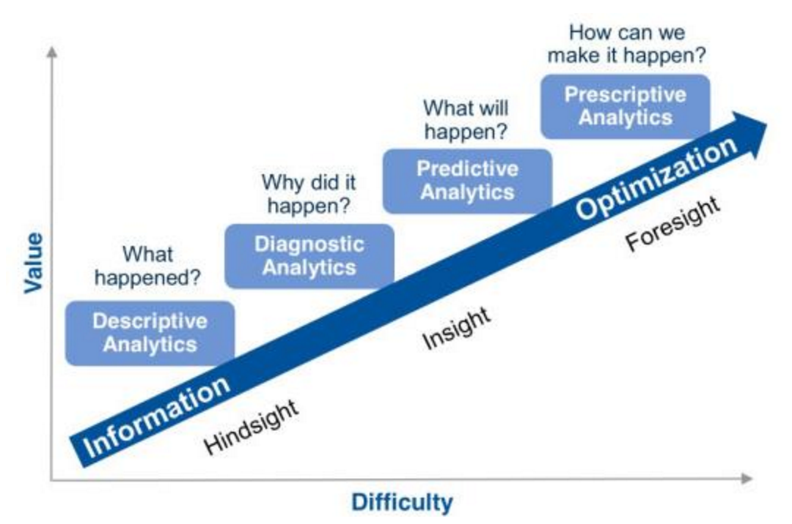
Model the Data
Notes:
Modelling is where we look for patterns and insights hidden in the data. It’s where machine learning comes in. We’ll look later at how to learn relationships between numbers, categories and graphs.

Slide 17
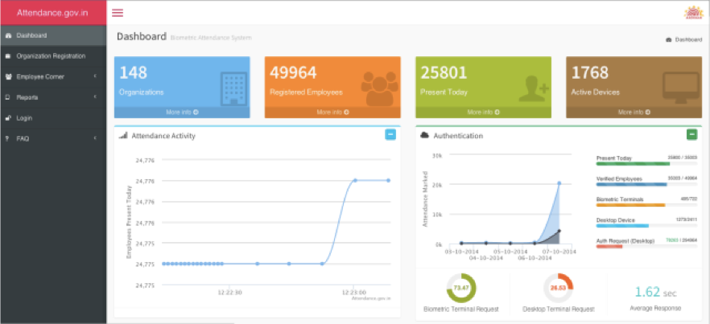
Communicate results
Notes:
We want to get this effect: ”I already knew that increased incarceration didn’t lower crime, but I wasn’t sure of the statistics. To see it on the graphs is really eye opening.” (Pandey et al, The Persuasive Power of Data Visualisation) – using whatever’s appropriate (which might or might not be visualisations).
We’re aiming at “ask good questions, tell good stories” - if you can do this with data, you’ve won.

Slide 18
What’s a Data Scientist?
Notes:
So who are these strange creatures who do data science?

Slide 19
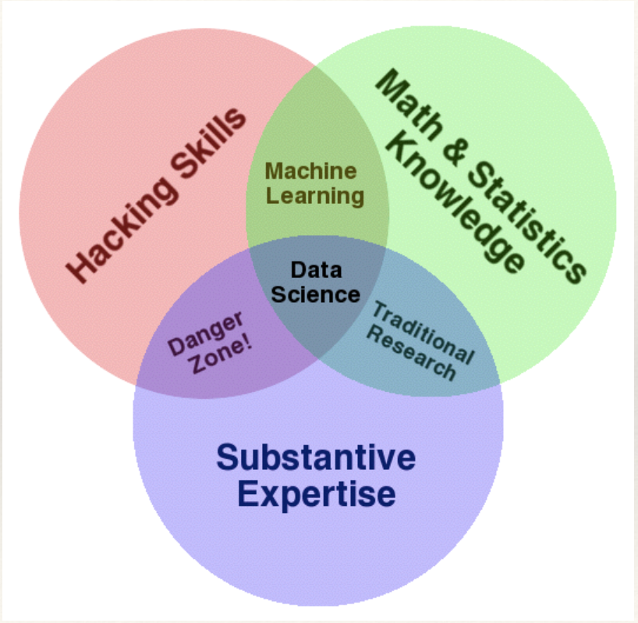
The Data Science Venn Diagram
Notes:
This is Drew Conway’s data science Venn diagram. It basically says that to be a data scientist, you need to know statistics, your business area and be able to code.
But it’s not quite like that. Many good data scientists don’t code at all, and you can build insightful visualisations without statistics. In this course, we assume that you already have expertise in development and statistics: we’re going to concentrate more on familiarization with data science ideas and building up your coding skills.

Slide 20
How do you become a data scientist?
Learning and Practice:
Kaggle - online datascience competitions
Driven Data - social good datascience competitions
Innocentive - some datascience challenges
CrowdAnalytix - business datascience competitions
TunedIt - scientific/industrial datascience challenges
Your own projects...
Notes:
Yes, you need to learn a bunch of theory, but there’s nothing like learning data science by doing it: you’ll handle issues you didn’t know existed, and learn many details about techniques by using them on non-sanitised data.

Slide 21
Should you become a data scientist?
Not necessarily. There are lots of data science students desperate for good problems to work on.
You might want to become someone who can work with data scientists
Which means learning how to specify data problems well
Notes:
Doing all the data science tasks on a project isn’t for everyone, and many data scientists are now working in teams, each of member of which may have different specialisations.
One of these specialisations is the data science business analyst - someone who can work with stakeholders to work out the right questions to be asked using data, and understand the nuances of communication, interpretation and issues like privacy and security.

Slide 22
Problem examples: Data Science Competitions
Notes:
One of the purest forms of split between data scientists and people who work with data scientists is data science competitions.

Slide 23
Competitions: Who Does What
Ask an interesting question
Get the data
Explore the data
Model the data
Communicate and visualize your results
Problem Owner
Competitor
?
Notes:
Data science competitions are different. The problem owner doesn’t have to do data modelling or machine learning themself, but they do need to be able to specify a problem well, find and clean data related to that problem so that competitors can access it easily (and all have the same starting dataset), and specify how the competition results will be marked (e.g. by accuracy on an unseen ‘test’ dataset).

Slide 24
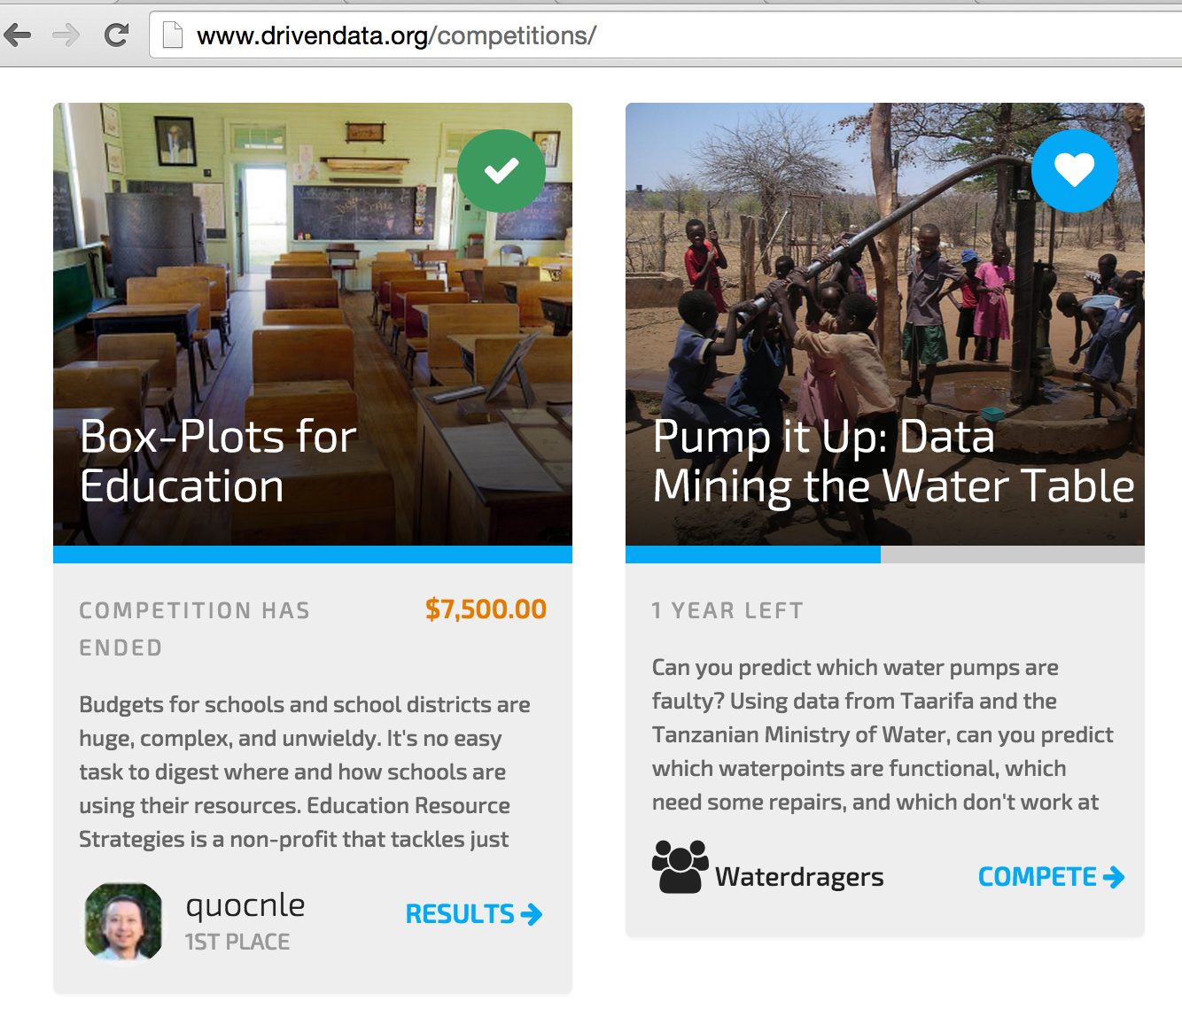
DrivenData
Notes:
http://www.drivendata.org

Slide 25
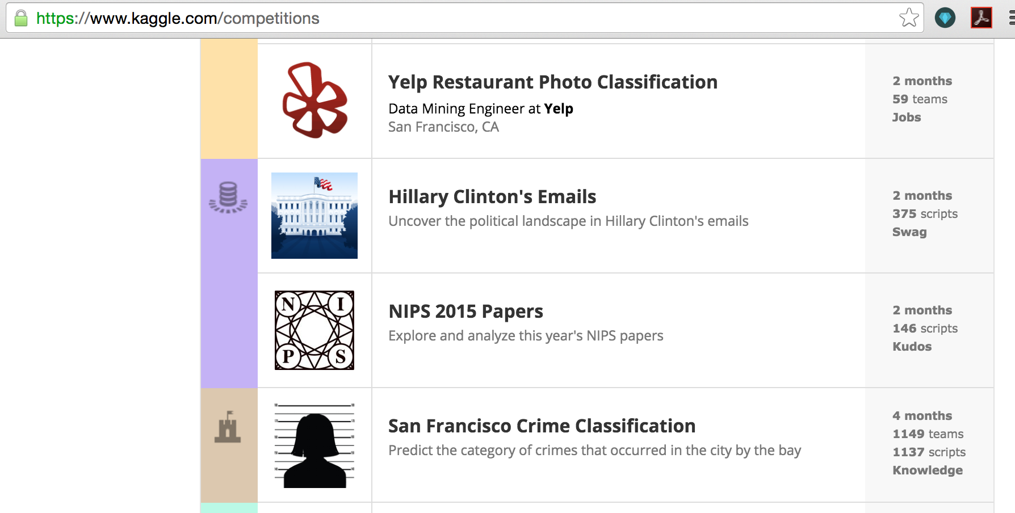
Kaggle
Notes:
https://www.kaggle.com

Slide 26
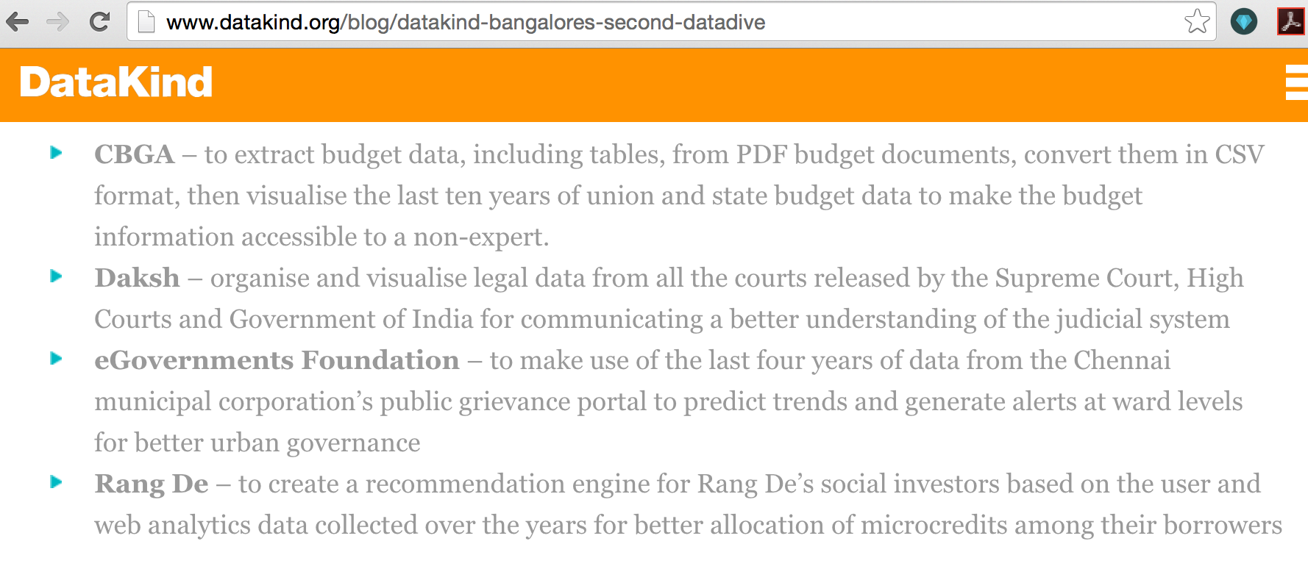
DataKind
Notes:
http://www.datakind.org - If you’re in Bangalore, you’re in luck: Thoughtworkers help lead the DataKind chapter there.

Slide 27
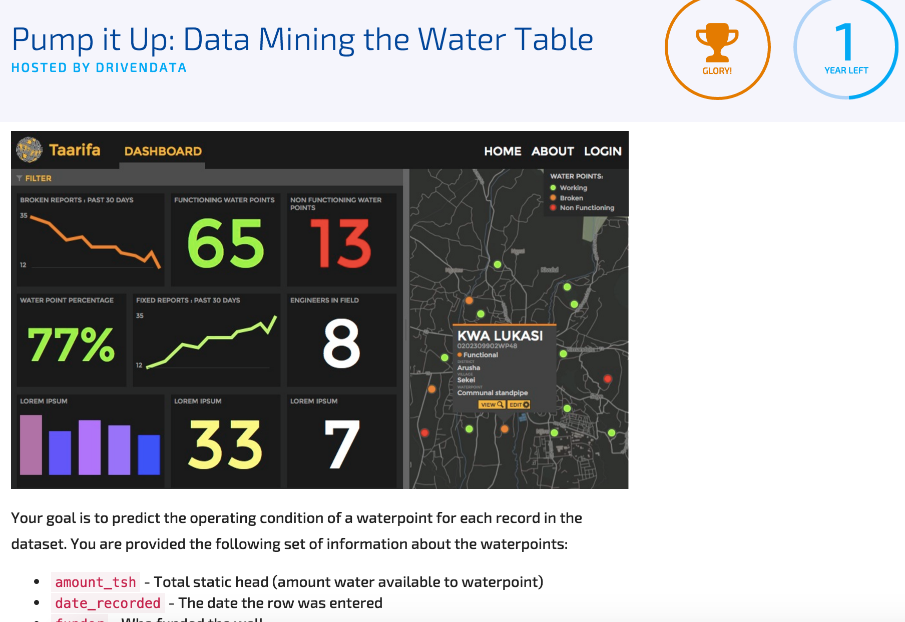
Example project: Pump It Up
Tanzania wells:
“Your goal is to predict the operating condition of a waterpoint for each record in the dataset”
Notes:
http://www.drivendata.org/competitions/7/

Slide 28
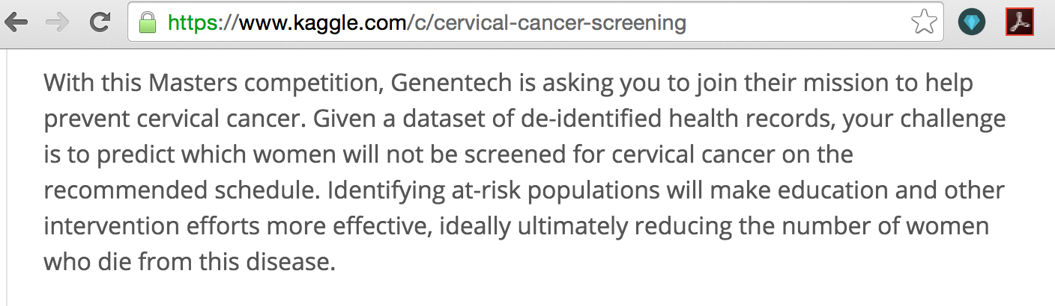
Example project: Cervical cancer

Slide 29
Writing a Problem Statement

Slide 30
DrivenData competition guidelines
Impact: “… clear win for the organisation in terms of effective planning, resources saved or people served… good story around how they generate social impact…”
Challenge: “… challenging enough for a rich competition…”
Feasibility: “….the right kind of data to answer the question at hand… does it have enough signal to be useful?...”
Privacy: “… can answer this question while protecting the privacy of individuals in the dataset and the operational privacy of an organisation…”
Notes:
http://www.drivendata.org/partners/

Slide 31
Design your project
Context: who needs this work, and what are they doing it for?
Needs: what are you trying to fix
Vision: what do you expect your final result to look like?
Outcome: how do you get your results to the people who need them? What happens next?
Notes:
Max Shron lists these 4 things (using the acronym CoNVO) that you need to think about when scoping a data science question.

Slide 32
Design your questions
Is the question concrete enough?
Can you translate the question into an experiment?
Is it actionable?
What actions will be taken given the answer?
What data is needed to do the analysis?
Notes:
Look at existing data science projects for inspiration on questions:
kaggle.com
http://www.drivendata.org/competitions/
http://www.datakind.org/blog/
Datasets could be anything - tables, images, maps, sensor feeds; anything.

Slide 33
Data Science Ethics

Slide 34
Data Risk and Ethics
You’re responsible for your data outputs
Could your outputs increase risk to anyone?
How will you respect privacy and security?
Notes:
“If you make a dataset public, you have a responsibility, to the best of your knowledge, skills, and advice, to do no harm to the people connected to that dataset. You balance making data available to people who can do good with it and protecting the data subjects, sources, and managers.” - Sara Terp, 2015
Examples of what not to do:
How bad data fed the Ebola epidemic, New York Times, 2015

Slide 35
Data Risk
Risk: “The probability of something happening multiplied by the resulting cost or benefit if it does”
Risk of: physical, legal, reputational, privacy harm
Likelihood (e.g. low, medium, high)
Risk to: data subjects, collectors, processors, releasers, users
Notes:
Quote: Oxford English Dictionary
There are three parts to risk: cost/benefit, probability and subject (risk to whom?).

Slide 36
PII: Personally Identifiable Information
“Personally identifiable information (PII) is any data that could potentially identify a specific individual. Any information that can be used to distinguish one person from another and can be used for de-anonymizing anonymous data can be considered PII.”

Slide 37
PII Red Flags
Names, addresses, phone numbers
Locations: lat/long, GIS traces, locality (e.g. home + work as an identifier)
Members of small populations
Untranslated text
Codes (e.g. “41”)
Slang terms
Can be combined with other datasets to produce PII
Notes:
These aren’t all the things that can accidentally release PII, but it’s a start.

Slide 38
Exercises

Slide 39
3-minute exercise: Ask interesting questions
Either your own questions:
Questions that data might help with
Stories you want to tell with data
Datasets you’d like to explore
Or pick an existing question:
Competition questions: Kaggle, DrivenData
A data science project that interested you
Notes:
Look at existing data science projects for inspiration on questions:
kaggle.com
http://www.drivendata.org/competitions/
http://www.datakind.org/blog/
Datasets could be anything - tables, images, maps, sensor feeds; anything.

Slide 40
3-minute exercise: Get the data
Pick one of your questions
List the ideal data you need to answer it
List the data that’s (probably) available
Think about what you’ll do if the data you need isn’t available
What compromises could you make
Where would you look for more data
Are there proxies (other datasets that tell you something about your question)
Are there ways to get more data (surveys, crowdsourcing etc)
Notes:
This is a paper exercise: you don’t need to search online or ask your contacts.

Slide 41
3-minute exercise: design your communications
List the types of people you’d want to show your results to
How do you want them to change the world? Can they take actions, can they change opinions etc
Describe the types of outputs that might be persuasive to them - visuals, text, numbers, stories, art… be as wild with this as you want

Slide 42
Things to do before next week
See file Tool Install Instructions
Make friends with the terminal window
Install iPython
Install Git
Notes:
You don’t have to install *all* the tools at once: just start with the tools for week 1 of class. And don’t worry if this doesn’t work smoothly: contact me, and I’ll work it out with you.

